Slide 1
Social Media Project by Shaik Samiya Shireen

Slide 2
AGENDA
PROBLEM STATEMENT 3
APPROACH 4
TECH-STACK USED 5
DATA SCHEMA 6
INSIGHTS & RESULTS & CONCLUSION 7-12

Slide 3
PROBLEM STATEMENT
You are hired as a data analyst at Meta and asked to collaborate with the Marketing team. Marketing teams want to leverage Instagram's user data to develop targeted marketing strategies that will increase user engagement, retention, and acquisition.

Slide 4
APPROACH
DATABASE CREATION: Created and inserted the values in the database using the DDL & DML SQL queries provided by the product manager (as per project) in the MySQL database using MySQL workbench.
EXTRACTION OF INSIGHTS: After creating the database required insights are generated from the database tables by running SQL queries in MySQL workbench.

Slide 5
TECH-STACK USED
Used MySQL Community Server — GPL Version 8.0.29 and Connector Version C++ 8.0.32 for creating my project as MySQL Community Server — GPL is a free and open-source relational database management system that uses SQL.

Slide 6
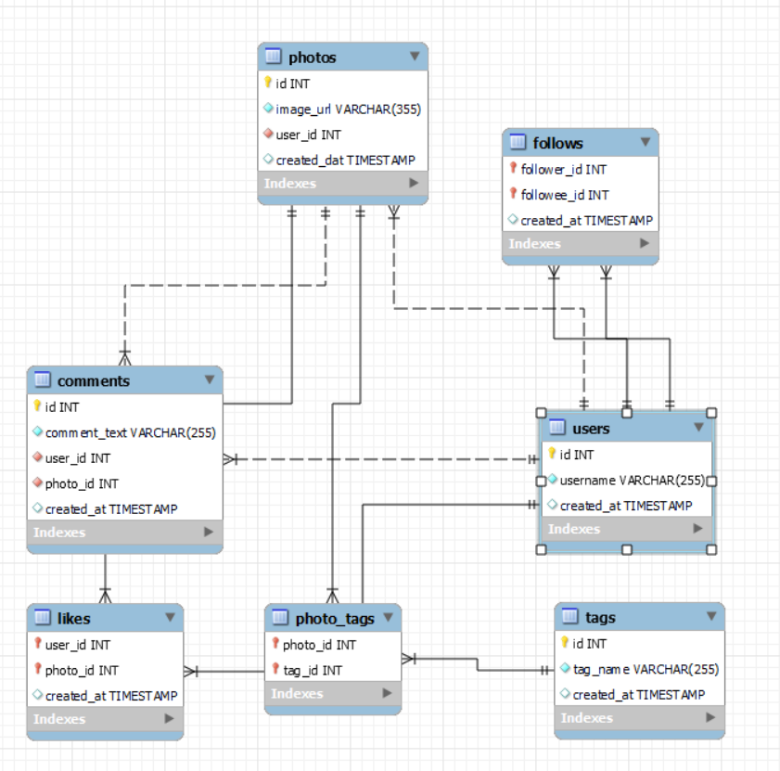
DATA SCHEMA

Slide 7
INSIGHTS

Slide 8
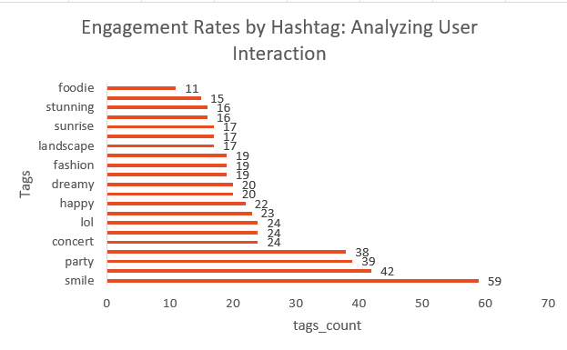
#1 - INSIGHT:
Recognizing the most popular tags. For instance, tags related to lifestyle, travel, or fitness may dominate, indicating user interests.
Recommendations:
Encourage users to use popular tags by creating challenges or rewards. For example, offer features or prizes for posts with the most engagement under specific tags.
Collaborate with influencers who use popular tags to reach wider audiences and increase credibility. Their established follower base can drive engagement for campaigns.

Slide 9
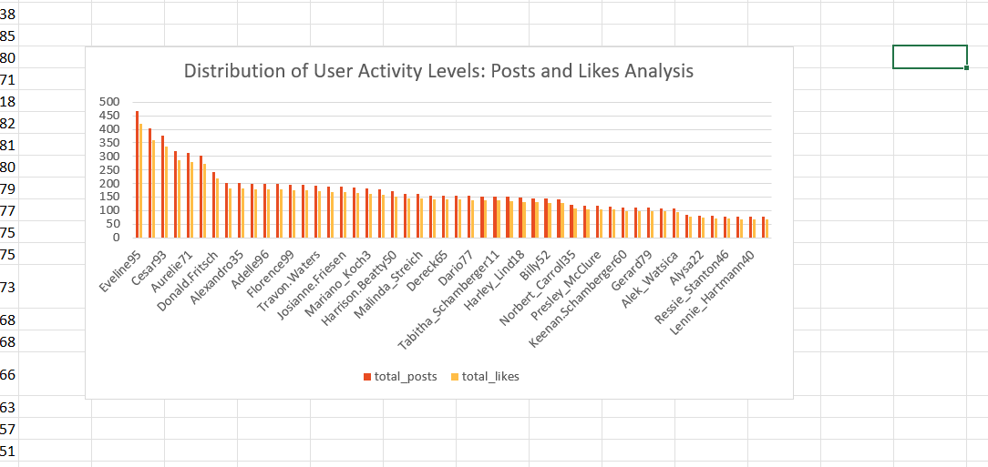
#2 – INSIGHT:
Analyzing the total number of posts, likes per user reveals significant patterns in user engagement. Users who post frequently tend to generate more likes indicating strong audience interaction.
RECOMMENDATIONS:
To enhance engagement, encourage users to increase their posting frequency while maintaining high-quality content.
Implement features such as posting reminders or content creation tips to facilitate more consistent sharing.
For users who show high engagement despite low posting frequency, provide personalized content strategies to help them produce more posts that align with their audience's interests.

Slide 10
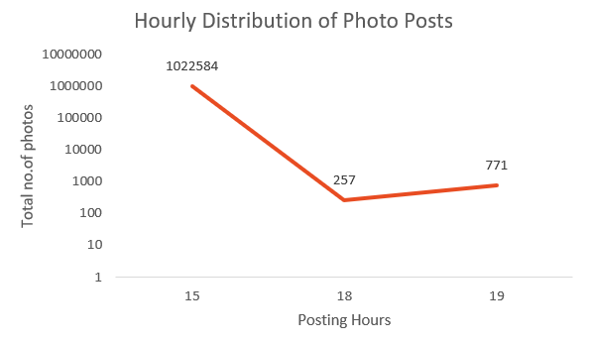
#3 – INSIGHT:
By tracking the number of posts created over time, you can identify periods of high activity that may correlate with specific events or trends.
Recommendations:
Analyze the data to find the hours with the highest number of posts, and schedule marketing campaigns during these times to maximize engagement.
Encourage users to post during peak hours to enhance visibility and attract more likes and comments on their content.
Send reminders to users before peak posting hours to encourage them to share content, increasing overall activity on the platform.

Slide 11
RESULTS
Data analysis using SQL queries to extract insights from database by which we track how users engage and interact with our digital product (software or mobile application) in an attempt to derive business insights for marketing, product & development teams.

Slide 12
CONCLUSION
Marketing team can reward the most loyal customers, send promotional emails to inactive users, use popular hashtags and most active day for brand promotions.
User engagement can be very useful success metric for the growth of the company.
Collaboration with the Marketing team to implement these strategies and monitor their effectiveness will be crucial for driving user engagement, retention, and acquisition.

Slide 13
Thank you
Shaik Samiya shireen
20/09/2024

